Slide 1
Coronavirus State and Local Fiscal Recovery Fund (SLFRF)
Final Rule Summary and Key Takeaways
January 27, 2022

Slide 2
Table of Contents
Overview of SLFRF Final Rule
Summary of Key Provisions for Awards Less Than $10 Million
Summary of Key Provisions for Awards Greater Than $10 Million

Slide 3
Overview

Slide 4
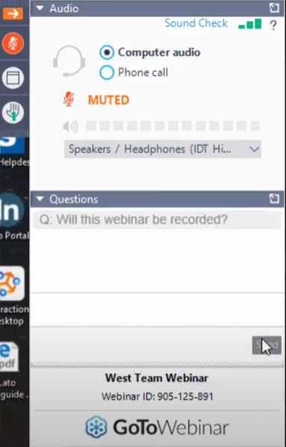
Webinar Overview
The webinar is divided into two sections:
Key provisions for those that received less than $10 million in LFRF funds
Key provisions for those that received more than $10 million in LFRF funds
At the end of the first section, NEUs are invited to drop off the line as the second half only applies to larger recipients.
Due to the structure of the webinar, we are not doing a formal Q&A at the end of the session. We invite you to post your question into the Question box in the webinar control panel and Guidehouse will deliver written responses for all questions to all attendees.
This webinar is specific to the SLFRF Final Rule and will NOT cover SLFRF reporting requirements. Guidehouse will host a separate reporting webinar for NEUs as the deadline approaches.

Slide 5
Overview of the SLFRF Final Rule
On January 6, 2022, Treasury released the SLFRF Final Rule, providing a final set of eligible uses for SLFRF funds.
Under the Final Rule, Treasury is employing a standard allowance of $10 million for revenue replacement for all recipients. This means that all LFRF money up to $10 million can be assigned to the “Revenue Replacement” category.
The Final Rule:
Incorporates Treasury’s response to comments and recommendations from funding recipients.
Provides increased flexibility in use of Coronavirus State and Local Fiscal Recovery Funds.
Provides a clearer process for considering the eligibility of use cases not outlined in the original guidance.

Slide 6
Key Provisions for Awards Up To $10 Million
Revenue Loss and Provision of Government Services

Slide 7
Updates to Replacing Lost Public Sector Revenue – Standard Allowance
New Standard Allowance for Revenue Loss
Provision of Government Services Defined
Treasury will allow recipients a standard allowance for revenue loss of $10 million.
If you receive less than $10 million in LFRF, you will not need to perform the revenue loss calculation.
Treasury clarifies that eligible government services “generally include any service traditionally provided by a government.”
This clarifies the “broad latitude” referenced in the IFR that recipients have in defining these services.

Slide 8
Example – Storm Water Culvert Project
Eligibility Considerations
(Old) Interim Final Rule (IFR) Guidance | (New) Final Rule (FR) Guidance
Eligible under Expenditure Category 5.6 – Clean Water: Stormwater. | Now that your entire allocation is eligible under 6.1 Revenue Replacement, where previously you could place this project under Expenditure Category 5.6 or 6.1, we are recommending that you place this under 6.1 because it will make your reporting far easier.

Slide 9
Prohibited Uses of LFRF
Recipients may not fund capital projects funded with borrowed money. All capital projects funded with LFRF money must be paid with “cash-on-hand”
Recipients may not pay down debt or pay interest on debt with LFRF money
Recipients may not deposit LFRF money into pension funds
Recipients may not use LFRF money to offset a reduction in net tax revenue resulting from a change in law, regulation, or administrative interpretation
Recipients may not use LFRF money to undermine COVID-19 mitigation practices in line with CDC guidance and recommendations
Recipients may not use LFRF money for any settlements and judgements
Recipients may not use LFRF money in violation of the Award Terms and Conditions or conflict of interest requirements under the Uniform Guidance

Slide 10
Considerations for Prime Recipients
If you received less than $10 million, your reporting will be significantly easier if you categorize your full LFRF allocation toward ‘Revenue Replacement’ using the new standard allowance.
Any SLFRF eligible expense that is the normal cost of doing town business can be categorized under Expenditure Category 6.1 – Revenue Replacement.
Revenue Replacement has much easier reporting requirements, when compared to other expenditure categories.
Using the revenue replacement category makes reporting easier but does not change the fact that you must comply with Federal Uniform Guidance.

Slide 11
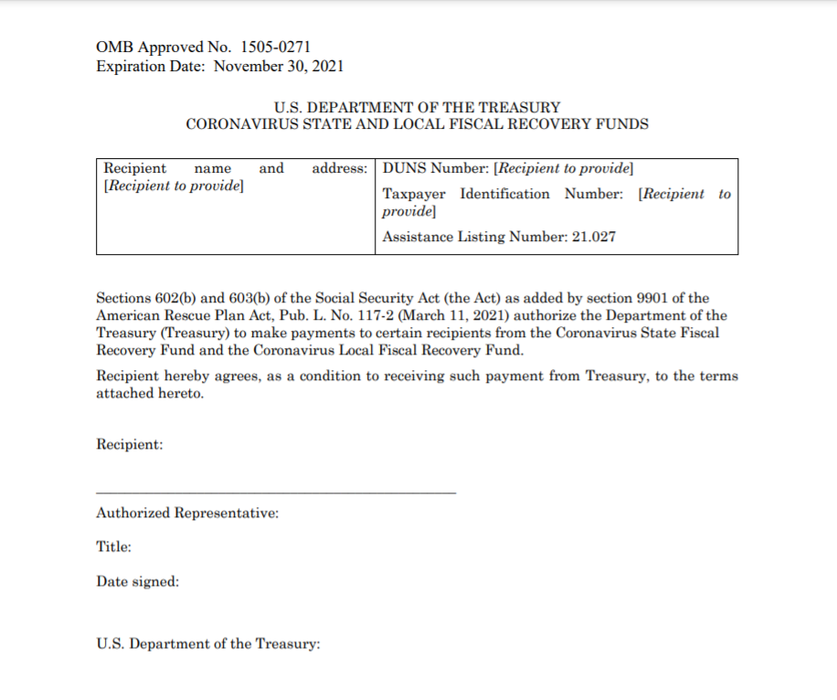
Compliance
Your obligations were in the Awards and Conditions you signed when you accepted the LFRF funds.
Includes Uniform Guidance Administrative Requirements, Cost Principles, and Audit Requirements (2 CFR 200): rules that apply to all federal grant dollars.
Uniform Guidance includes requirements around:
Subrecipient monitoring
Single audit
Procurement

Slide 12
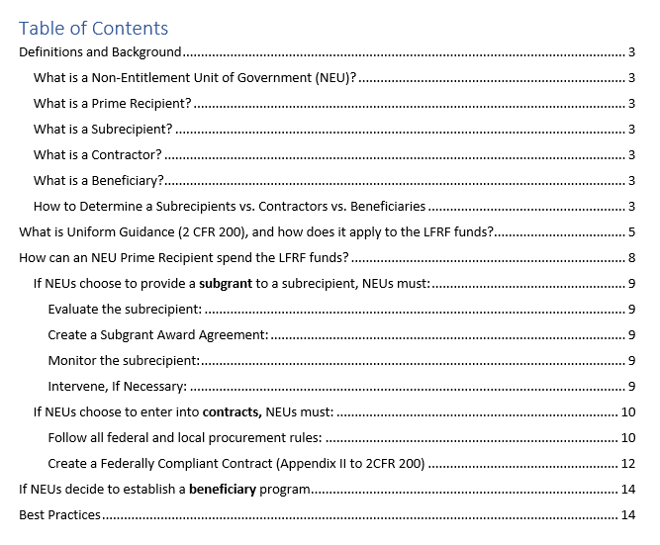
Uniform Guidance Desk Reference
Details on complying with Uniform Guidance can be found in the Uniform Guidance Desk Reference, which is available on the GOFERR website.
If you’re concerned about compliance with federal grant rules, one option would be to use SLFRF funds to cover payroll expenses and then use your payroll budget for other project investments.

Slide 13
April 30th Reporting
If you received less than $10 million, you do not have submit a Project and Expenditure report until April 30, 2022.
Treasury has indicated that additional guidance will be released before the April deadline.
We will host a reporting webinar for recipients who received less than $10 million closer to the deadline.
In New Hampshire, this is any recipient except:
The State
Belknap County
Cheshire County
Grafton County
Hillsborough County
Manchester
Merrimack County
Nashua
Portsmouth
Rockingham County
Strafford County

Slide 14
Recipients of less than $10 million can drop from the line.
Reminder: If you have a question, please post it in the question box in your control panel. Guidehouse will release written responses to all questions after the webinar.

Slide 15
Key Provisions for Awards Greater Than $10 Million
Additional Changes

Slide 16
Methods for Determining Revenue Loss
Recipients can choose the option that offers them the greatest benefit.
Either method offers the same broad definition of the provision of government services and allows for easier reporting.
You must pick a method in your January 31 report however, you will be able to change that method in your April 30 report.
After your April 30 designation, you cannot change your selected method.
Standard allowance of $10 million
OR
Formula-based revenue loss calculation

Slide 17
Updates to Replacing Lost Public Sector Revenue – Formula Based
More Generous Revenue Loss Formula
Can Now Be Calculated at Fiscal Year End
Revenue Totals Must Be Adjusted for Tax Changes
Changes to Definition of General Revenue
Minimum counterfactual growth rate increased from 4.1% to 5.2%.
This more generous formula will increase the amount of revenue loss that can be claimed by recipients.
Revenue loss must be calculated at four distinct points in time – these can now be recipients’ fiscal year end, reducing financial error and workload associated with reporting.
Under the Final Rule, recipients must exclude revenue impacts due to tax changes that are adopted after January 6, 2022, meaning tax increases will not impact recipients lost revenue calculation
The definition of General Revenue has been expanded to include revenue from utilities and publicly operated liquor stores in revenue loss calculations.
The Government Finance Officers Association (GFOA) has developed a revenue loss calculator that can help in determining your formula-based revenue loss in compliance with the Final Rule.

Slide 18
For any funds over $10 million or your calculated revenue loss…

Slide 19
Top Line Changes from the IFR to the Final Rule
Category | Change
Responding to Public Health and Economic Impacts | Clearer definitions of who is an eligible beneficiary of assistance (including low- and moderate-income definition) and eligible forms of assistance Allows categorical eligibility (Medicaid/SNAP/TANF) for some federal programs Broader uses and more flexibility in providing public sector employment support
Premium Pay | Expanded list of sectors and occupations eligible for premium pay
Water and Sewer Infrastructure | Broadened eligibility of projects (including stormwater infrastructure, residential wells, lead remediation, and certain rehabilitations of dams and reservoirs)
Broadband Infrastructure | Broadened eligibility – now includes cybersecurity investments New low-income subsidy requirement for projects serving households
Other New Themes | Reorganization of guidance with clearer framework for eligibility under each statutory use Framework for evaluating eligible uses beyond those listed in the guidance Eligibility criteria for capital projects

Slide 20
Updates to Responding to Public Health and Economic Impacts of COVID-19 (1/4)
The Final Rule provides examples of eligible beneficiaries by category (households, communities, small businesses, and nonprofits). In addition, the Final Rule outlines examples of eligible forms of assistance for each of these beneficiaries.
The Final Rule also provides a definition of low- or moderate-income households and communities that Treasury presumes were negatively impacted by the pandemic and provides a tool to assist with determinations on its website:
“Low- or moderate-income households and communities are those with (i) income at or below 300 percent of the Federal Poverty Guidelines for the size of the household based on the most recently published poverty guidelines or (ii) income at or below 65 percent of the area median income for the county and size of household based on the most recently published data.”

Slide 21
Updates to Responding to Public Health and Economic Impacts of COVID-19 (2/4)
In addition to households residing in Qualified Census Tracts, low-income households may now be presumed to be disproportionately impacted by the pandemic (and therefore are eligible for a wider range of services).
The Final Rule also provides a criteria for determining if an industry outside of the travel, tourism or hospitality sectors is considered to have been “impacted” by the pandemic and its negative economic effects and therefore eligible to receive assistance:
If the industry is outside the travel, tourism, or hospitality sectors, the industry is impacted if:
The industry experienced at least 8 percent employment loss from pre-pandemic levels, or
The industry is experiencing comparable or worse economic impacts as the national tourism, travel, and hospitality industries as of the date of the final rule, based on the totality of economic indicators or qualitative data (if quantitative data is unavailable), and if the impacts were generally due to the COVID-19 public health emergency.

Slide 22
Updates to Responding to Public Health and Economic Impacts of COVID-19 (3/4)
The Final Rule also allows for categorical eligibility for certain other federal programs, which means that recipients may presume that households eligible for these other programs also meet the definition of “impacted” or “disproportionately impacted” for SLFRF.
Households that qualify for the following programs will be recognized as…
“Impacted” | “Disproportionately Impacted”
Children’s Health Insurance Program (CHIP) | Temporary Assistance for Needy Families (TANF)
Childcare Subsidies through the Child Care and Development Fund (CCDF) Program | Supplemental Nutrition Assistance Program (SNAP)
Medicaid | Free and Reduced-Price Lunch (NSLP) and/or School Breakfast (SBP) programs
National Housing Trust Fund (HTF), for affordable housing programs only | Medicare Part D Low-income Subsidies Supplemental Security Income (SSI)
Home Investment Partnerships Program (HOME), for affordable housing programs only | Subsidies Supplemental Security Income (SSI)
 | Head Start and/or Early Head Start
 | Special Supplemental Nutrition Program for Women, Infants, and Children (WIC)
 | Section 8 Vouchers
 | Low-Income Home Energy Assistance Program (LIHEAP)
 | Pell Grants
If the industry is outside the travel, tourism, or hospitality sectors, the industry is impacted if:
The industry experienced at least 8 percent employment loss from pre-pandemic levels, or
The industry is experiencing comparable or worse economic impacts as the national tourism, travel, and hospitality industries as of the date of the final rule, based on the totality of economic indicators or qualitative data (if quantitative data is unavailable), and if the impacts were generally due to the COVID-19 public health emergency.

Slide 23
Updates to Responding to Public Health and Economic Impacts of COVID-19 (4/4)
Recipients using SLFRF funds to restore and support public sector employment* may now pay for payroll and covered benefits associated with increasing budgeted FTEs up to 7.5% above pre-pandemic baseline
Note: additional analysis is needed to justify exceeding the baseline.
Recipients are also given greater flexibility in how funds can be used to support public sector employment. Eligible uses include:
Providing funding for employees who experienced pay reductions or were furloughed (minus any unemployment benefits received)
Maintaining current compensation levels (with adjustments for inflation) to prevent layoffs
Providing worker retention incentives, including “reasonable” increases in compensation (<10% of base pay for a group or <25% for an individual)
Administrative costs associated with eligible hiring, support and retention programs
*Note: Treasury has reorganized several uses under a new sub-category titled “restore and support public sector employment,” which is inclusive of eligible expenses under the previous “rebuilding public sector capacity.”

Slide 24
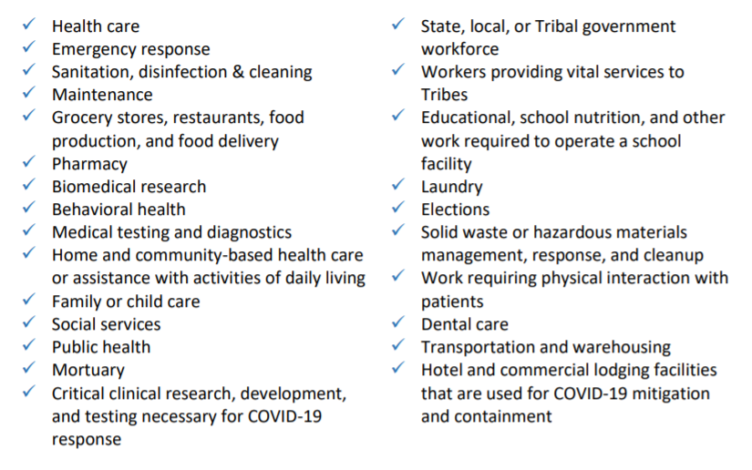
Updates to Premium Pay
The Final Rule provides an expanded list of sectors and occupations that are considered eligible for premium pay:

Slide 25
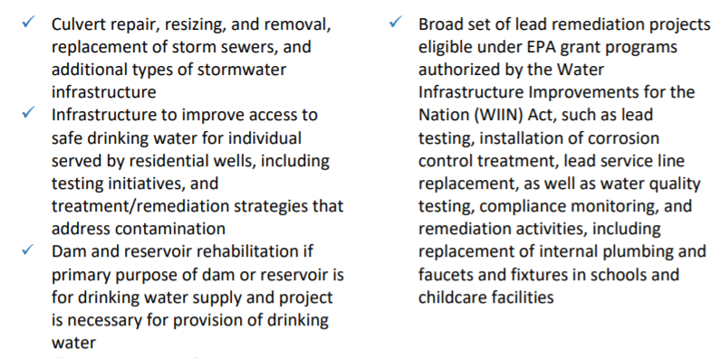
Updates to Water and Sewer Infrastructure
The Final Rule broadens eligibility to include additional types of projects beyond CWSRF and DWSRF, if they meet certain criteria outlined by Treasury:
The Final Rule also clarifies that recipients are required to assess cost-effectiveness of projects for the creation of new drinking water systems, dam and reservoir rehabilitation projects, or projects for the extension of drinking water service to meet population growth needs.

Slide 26
Updates Broadband Infrastructure
Broadens Uses Deemed Eligible to Include Cybersecurity Investments:
SLFRF may be used for modernization of cybersecurity for existing and new broadband infrastructure, regardless of their speed delivery standards. This includes modernization of hardware and software.
New Low-Income Subsidy Requirement:
For a Broadband project that provides service to households, the Final Rule specifies that recipients must require the service provider to provide access to low-income subsidy programming, either by:
Participating in the FCC’s Affordable Connectivity Program (ACP)
Providing access to a broad-based affordability program to low-income consumers that provides benefits commensurate to ACP

Slide 27
NEW: Steps for Evaluating Eligibility of Uses Beyond Those Listed in Guidance
Define Beneficiaries: Eligible uses must either target those “impacted” directly by the pandemic and its negative economic consequences or those “disproportionately impacted” who experience disproportionate public health or economic outcomes from the pandemic.
Develop a Reasonable and Proportional Response: Eligible uses must be reasonably designed to benefit the individual or class that experienced the impact. They must also be related and reasonably proportional to the extent and type of impact experienced.
For disproportionately impacted communities, interventions that address broader pre-existing disparities that contributed to more severe health and economic outcomes during the pandemic are allowed.

Slide 28
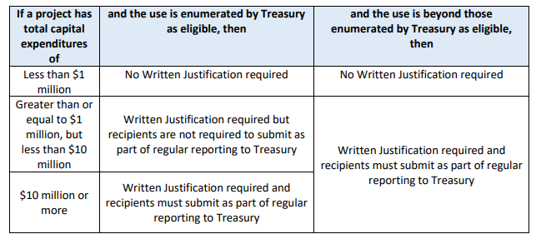
NEW: Capital Expenditures
The Final Rule clarifies that recipients may use funds for capital expenditures that respond to the public health and negative economic impacts of the pandemic, including building affordable housing, childcare facilities, schools, hospitals (see appendix for full list).
Any use of funds in this category for a capital expenditure must comply with the capital expenditure requirements (see chart below), in addition to other standards for uses of funds.

Slide 29
Considerations for Prime Recipients
In light of the new guidance, we recommend revisiting eligibility determinations previously made in order to ensure compliance with the new rule, particularly for projects that will continue beyond April 1, 2022.
Prime recipients may also want to proactively communicate with stakeholders, subrecipients and beneficiaries regarding updates in the Final Rule and implications for SLFRF-funded programs.
In addition, Treasury has indicated an FAQ for the Final Rule will be forthcoming; we expect this will provide additional information and clarification on key provisions.
We do not currently know whether or not projects that began before April 1, 2022 will have “grandfathered” eligibility. We are hopeful that Treasury will release guidance on this.

Slide 30
Your Guides
^{Hillary Thompson} ^{Director} ^{hthompson@guidehouse.com}
^{Gabriela Fowler} ^{Senior Consultant} ^{gfowler@guidehouse.com}
^{Siddharth Ramachandran} ^{Consultant} ^{sramachandran@guidehouse.com}

