Slide 1
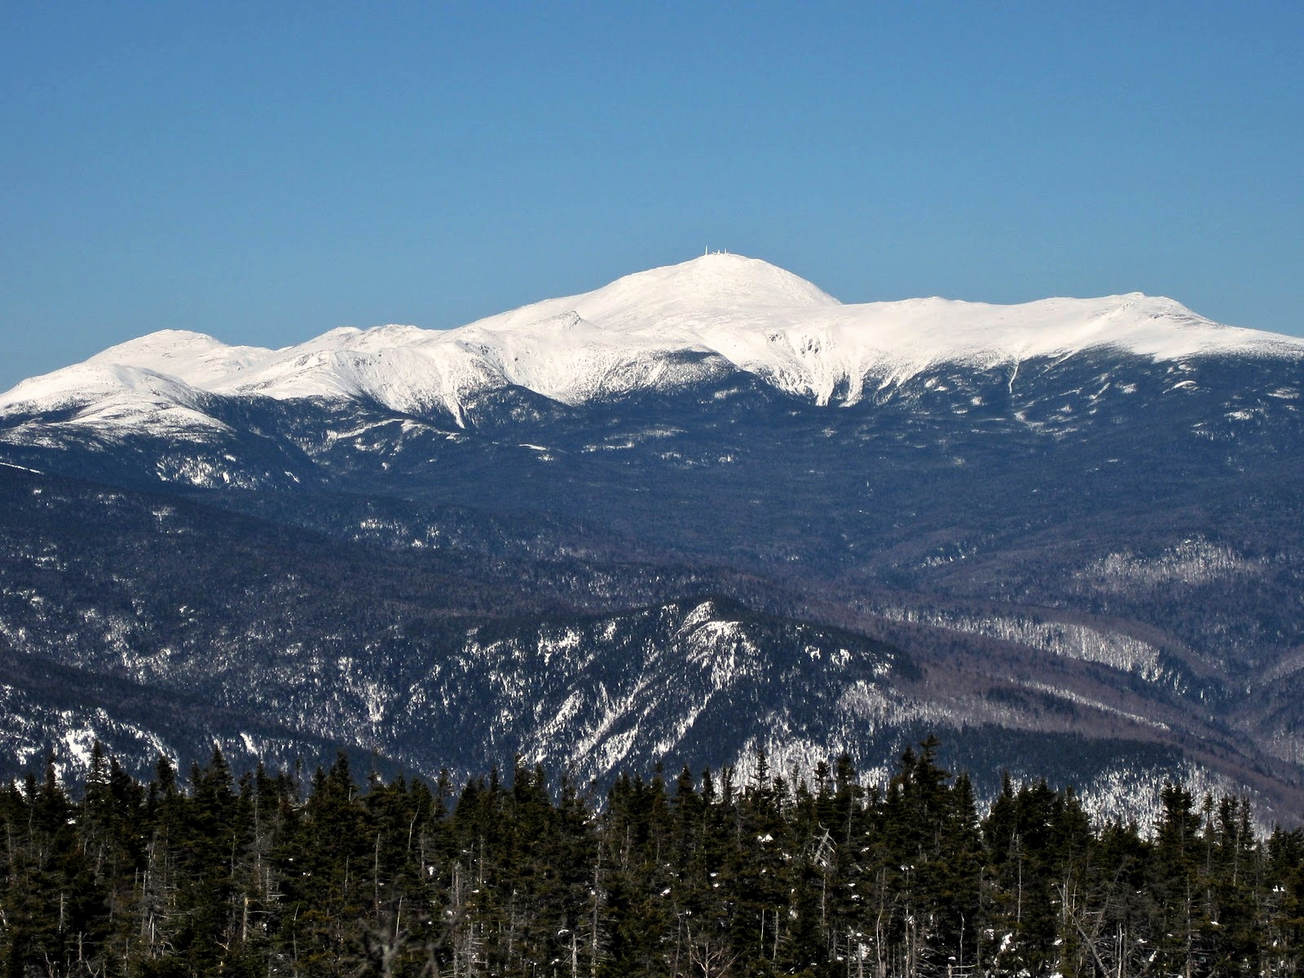
Northern Human Services
Northern Human Services
is a private non-profit essential provider
of behavioral health services,
developmental services and
substance use disorder treatment
located throughout northern New Hampshire.

Slide 2
Northern IS NOT A Sleeping GIANT
Northern Human Services has been a high quality non-profit human service provider that has worked collaboratively with the NH Department Of Health and Human Services for over 40 years.
It has an annual budget exceeding $42 million dollars per year.
The agency serves more than 4600 individuals and their families with developmental disabilities and mental health challenges each year. Northern serves individuals from birth until end of life.
The agency employs more than 660 people and is the largest employer in northern New Hampshire.
Northern provides services throughout Coos, Carroll and northern Grafton Counties operating more than 18 facilities across service sites. Our region is 155 miles from north to south.

Slide 3
SOURCES OF Revenue
Contract with the State of NH for the provision of Developmental Services
Contract with the State of NH for the provision of Behavioral Health Services
Three Contracts with Medicaid Managed Care Companies
Contracts with the NH Department of Justice for Victims of Crime Services
Contracts with the NH Department of Justice for Drug Court Services
Contracts with Commercial Insurance Companies (i.e. Anthem, Cigna, Harvard Pilgrim, etc.) for reimbursement for behavioral health services and some developmental services to very young children
Grants including the NH Charitable Foundation’s Tillotson Fund
Donations and Fundraising Efforts
Town Funding
Client Fees

Slide 4
Annual Revenue
TOTAL For Developmental Services $26,131,497
TOTAL For Mental Health $16,122,025
NORTHERN’S CURRENT TOTAL OPERATING REVENUE ON AN ANNUAL BASIS
$42,253,522

Slide 5
For Consideration
The COVID-19 pandemic is adversely impacting our capacity to deliver services and to keep employees working.
Northern Human Services does not qualify for the Federally Funded Payment Protection Program because we employ over 500 people.
Northern is the only State contracted Area Agency and Community Mental health Center in the entire state that did not qualify for this reason.
We have explored other funding relief options but there are not viable options available for nonprofits that meet our needs.

Slide 6
Who Benefits From Northern Staying in Business?
Over 4600 individuals and families receiving critical services each year and growing
660+ committed employees who live and support families in the North Country
The local economy of each community where we live and serve
Over 130 contracted Home Care Providers and Family Providers
Multiple vendor agencies and independent contractors that provide services under contract with Northern
Other community health care organizations, school districts, law enforcement agencies and social service providers depend on Northern for professional services and consultation 24/7 all year round; we NEVER close!

